Slide 1
Components of Effective Classroom Settings
Maximized Structure
Post, teach, model reinforce expectations
Active engagement
Varity of ways to acknowledge
Including success!
Continuum of ways to respond
(Simonsen, Fairbanks, Briesch, Myers, & Sugai, 2008)

Slide 2
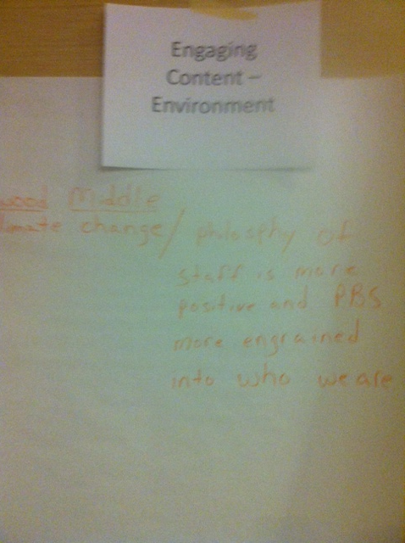

Slide 3
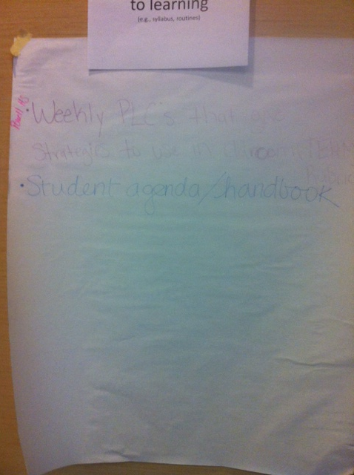

Slide 4
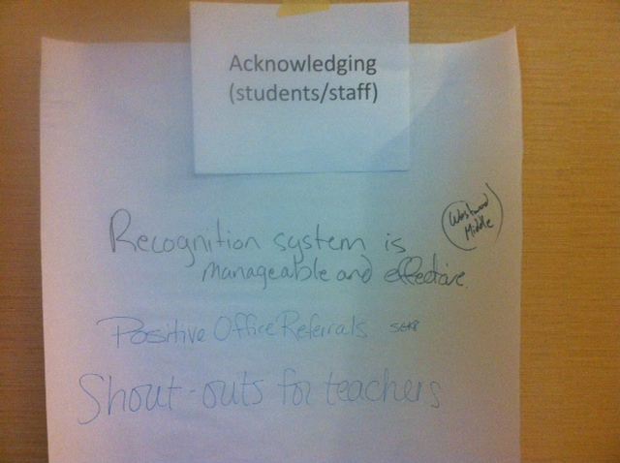

Slide 5
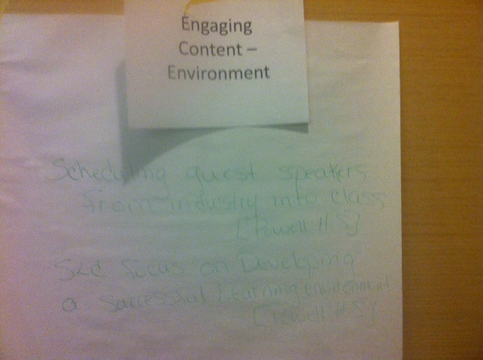

Slide 6
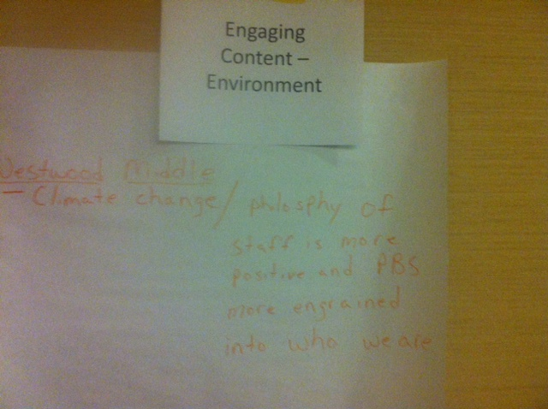

Slide 7
